Slide 1

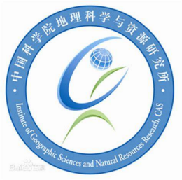

Faster and higher accuracy large scale water mapping using deep learning in Google Earth Engine
Dongxue Zheng¹, Xian Wang^{2,*}, Haoshan Wei^{2,3}, and Longhao Wang^{2,3,*}
¹
²
³

Slide 2

Table of contents
1. Introduction
2. Method
3. Results and discussion
4. Goal

Slide 3
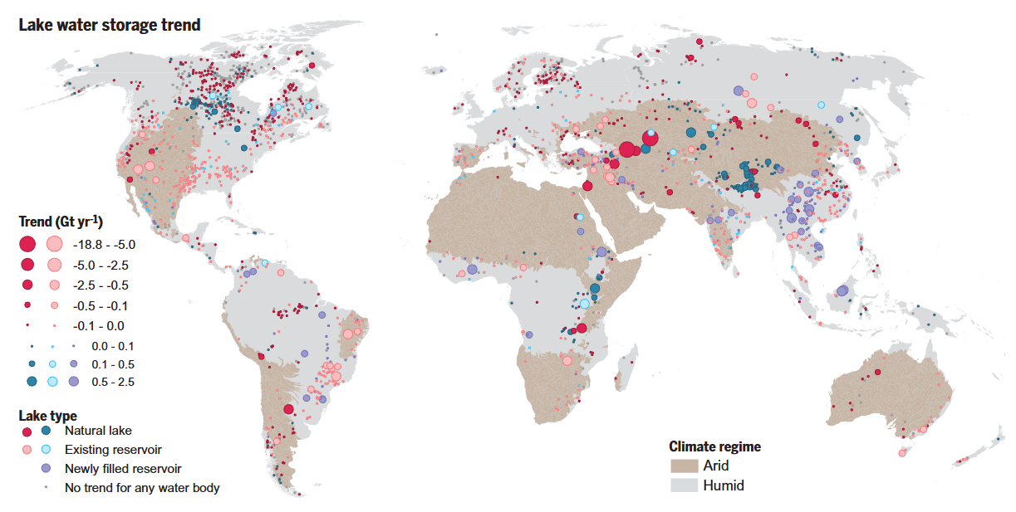
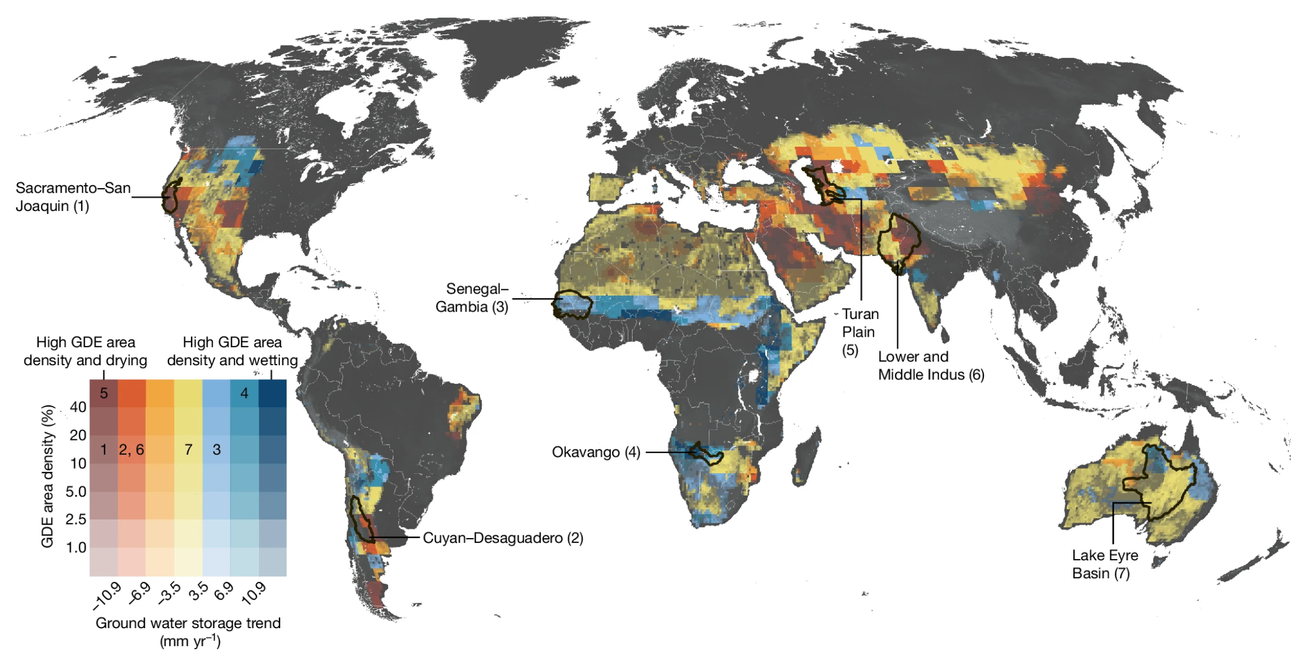
Introduction
(Yao et al., 2023, Science)
(Melissa et al., 2024, Nature)
Large scale satellite- and water-base key variables mapping is still a hot point

Slide 4
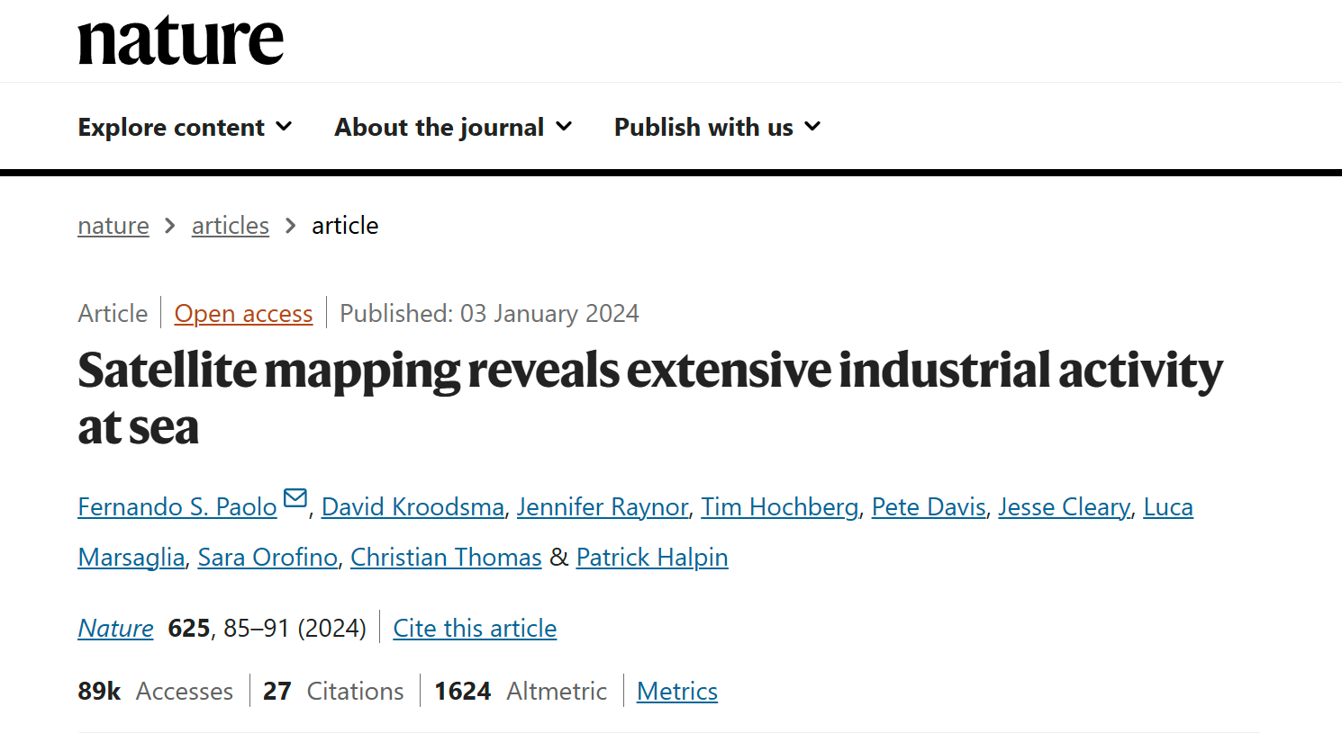
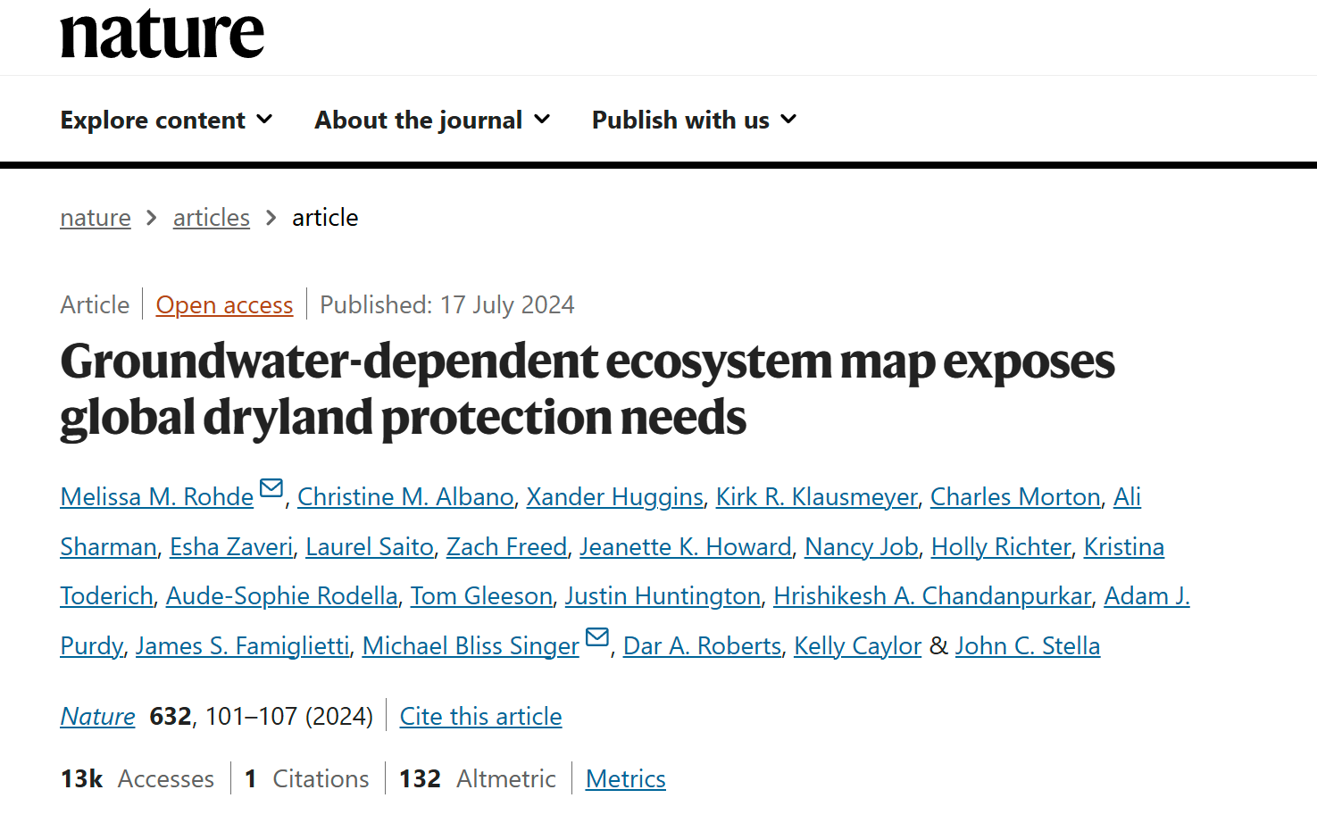
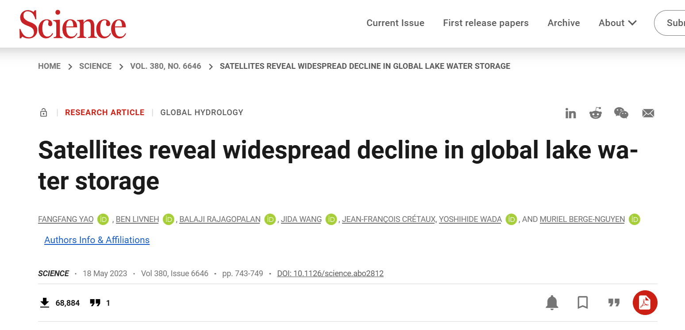
Introduction
They are ALL performed in Google Earth Engine
ALL using relative simple algorithum (E.g., RF)
Can we harness the latest AI model to do some interesting research?

Slide 5
Table of contents
1. Introduction
2. Method
3. Results and discussion
4. Goal

Slide 6
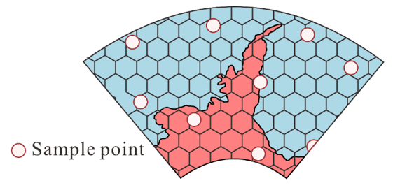
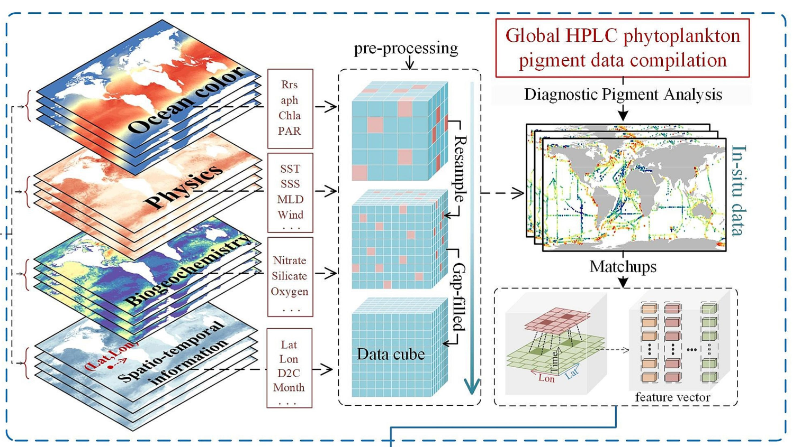

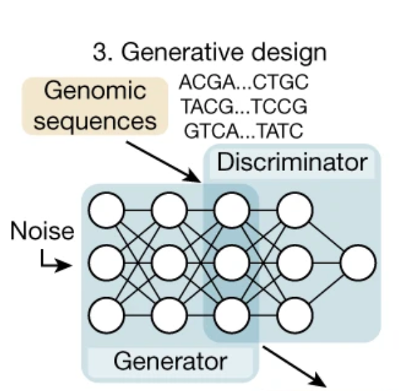
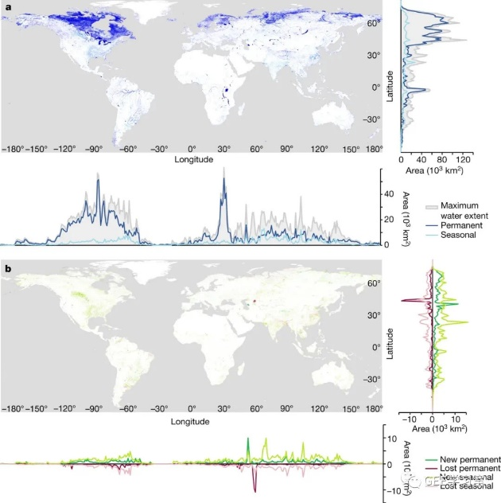
Method
2. Performing CNN in local GPU and export weight
4. Export global map to analysis
Get Training Data in GEE
3. Put weight to GEE and get result

Slide 7
Table of contents
1. Introduction
2. Method
3. Results and discussion
4. Goal

Slide 8
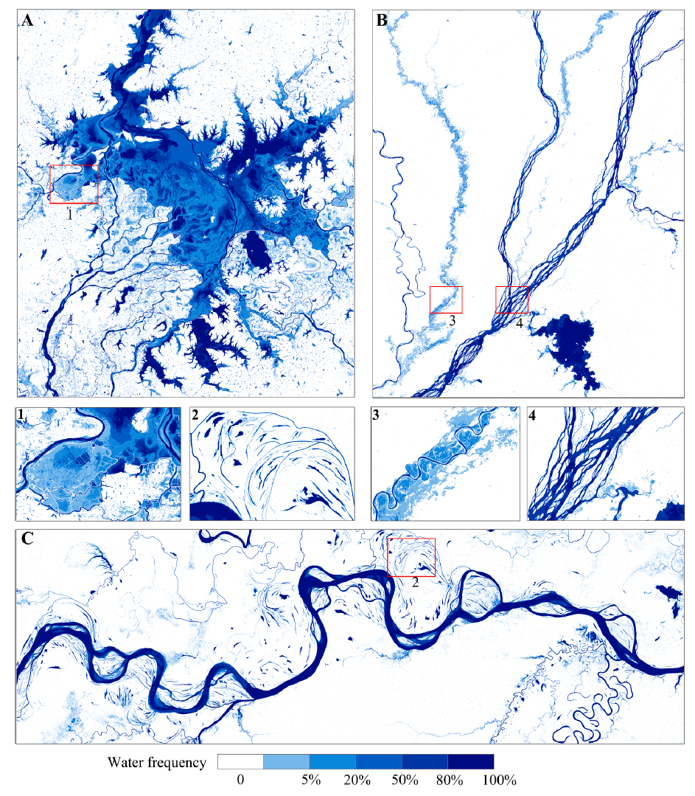
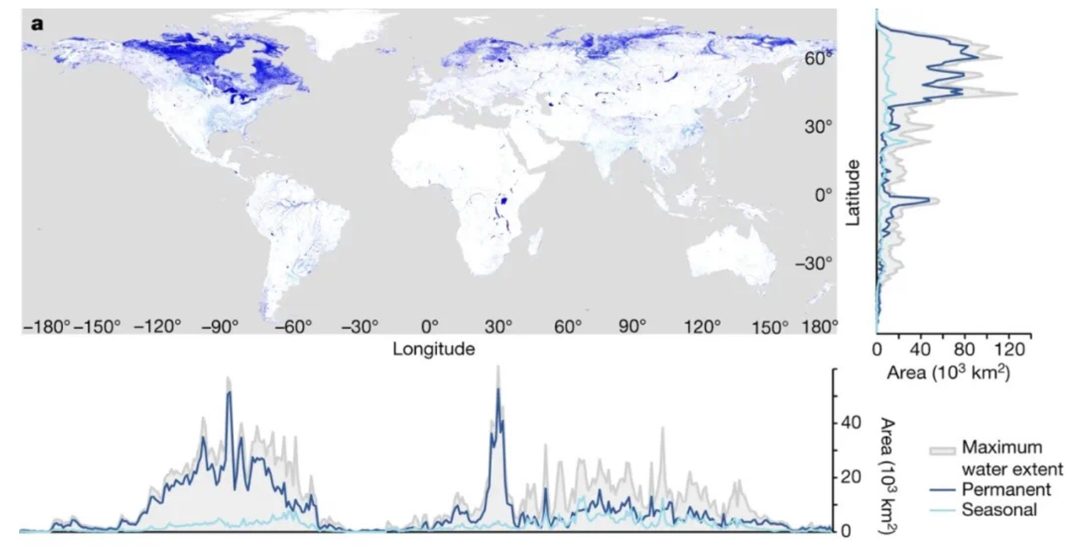
Results and Discussion
Figure 1. Visualization global and local surface water maps

Slide 9
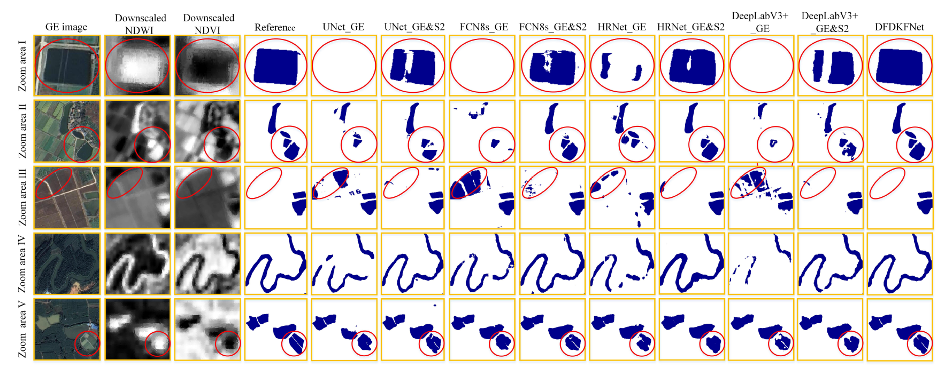
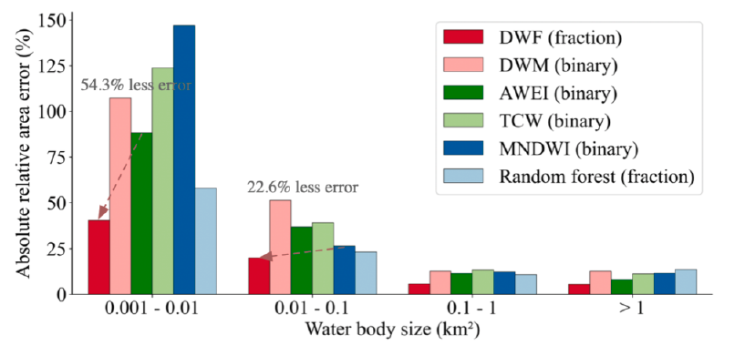
Results and Discussion
Figure 2. Comparing with traditional algorithm (RF, TH)

Slide 10
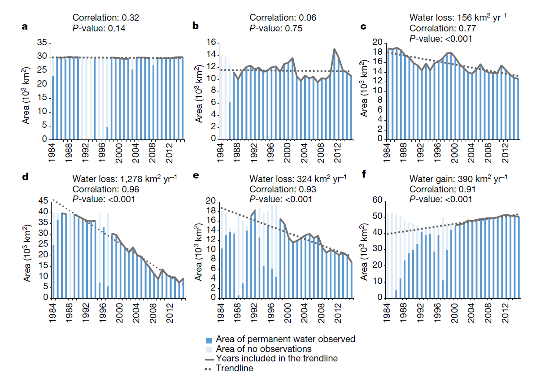
Results and Discussion
Figure 3. Time feature

Slide 11
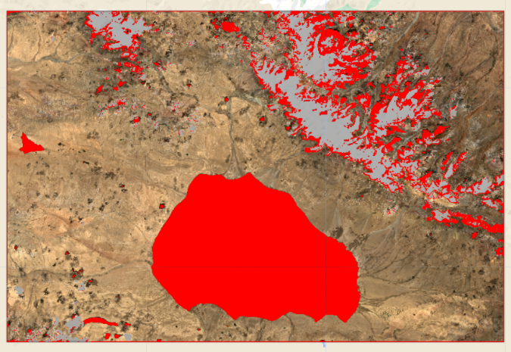
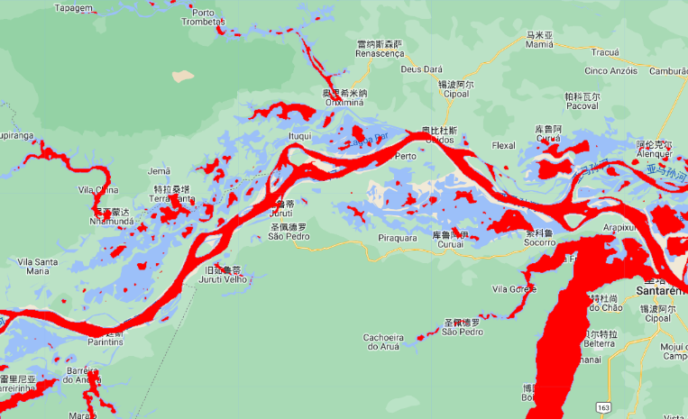
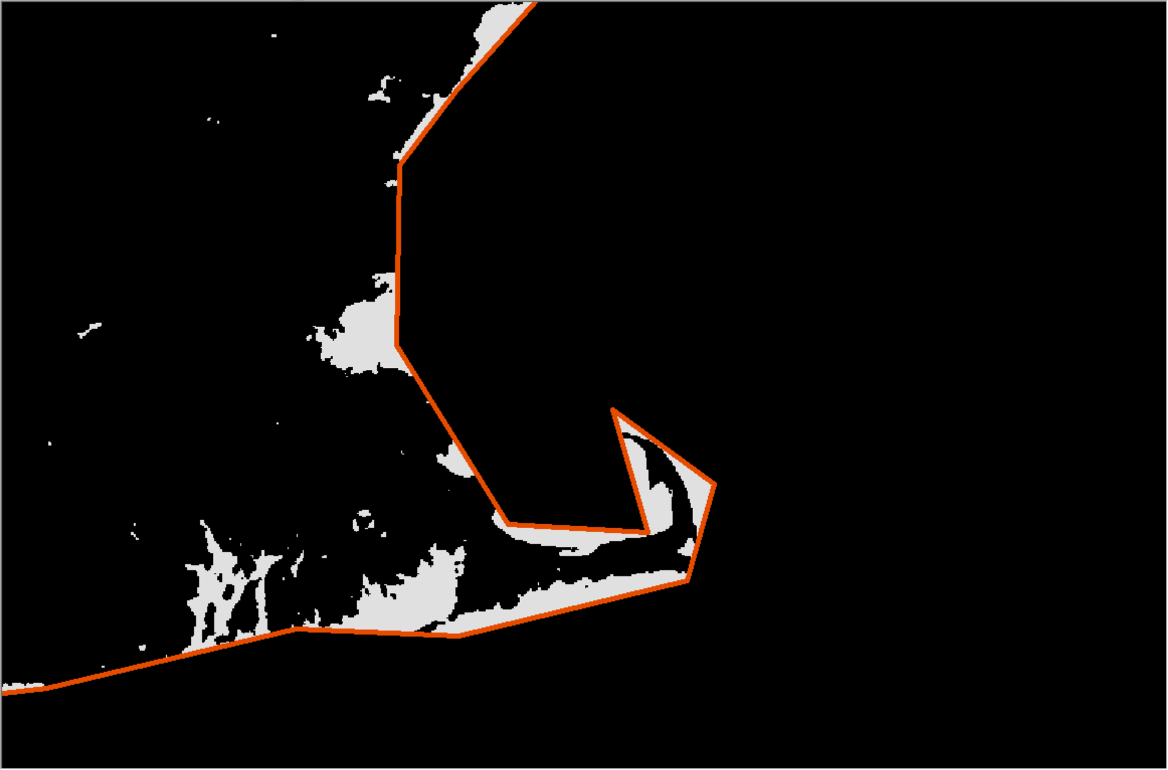
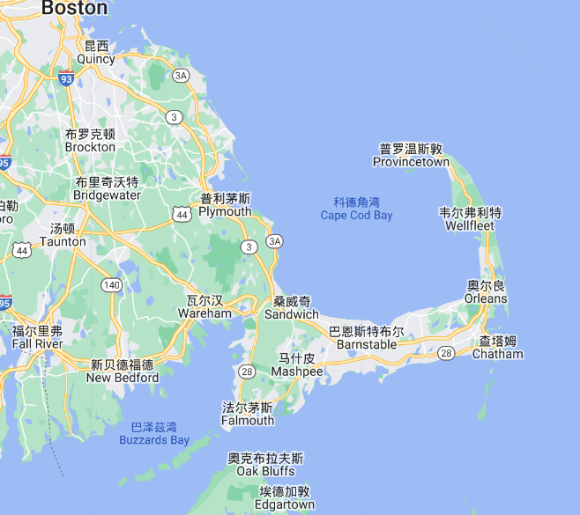
Results and Discussion
Figure 4? Regional plot like Tibetan Plateau ?
Sentinel after 2017 is OK?
Other simple problem

Slide 12
Table of contents
1. Introduction
2. Method
3. Results and discussion
4. Goal

Slide 13

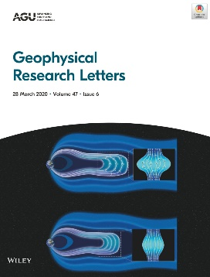
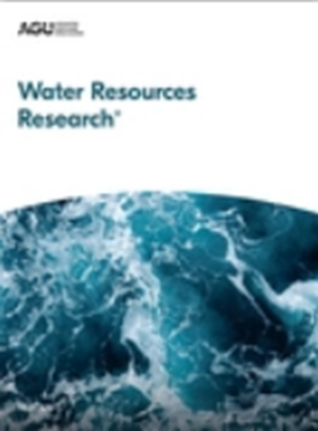

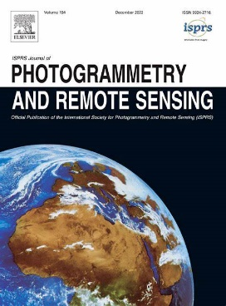
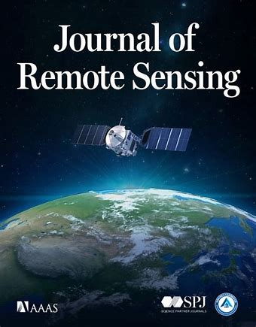

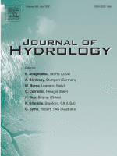
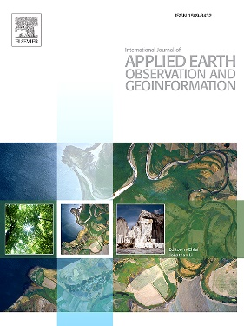
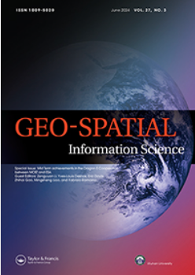

Goals
GRL RSE WRR ESSD
ISPRS JRS ERL JOH
JAG GSIS STOTEN
RS Water

Slide 14
Thank you for your attention!

